Slide 1
Effects of Educational Reforms in the Turkish context
Mustafa Yağız Kılıçarslan
Joel Gomez
Timothy Hanson

Slide 2
Table of contents
01
02
03
04
Introduction
Methodology
Description of the dataset
Background of the study
Causal question
Data cleaning
Feature engineering
Exploratory Data analysis
Machine learning models
Results
Conclusions
Outcomes and Limitations
Interpretation of the results

Slide 3
01
Introduction
Background of study

Slide 4
Introduction
In 2012 the Compulsory schooling mandate of Turkey increased schooling from 8 to 12 years. This policy change has impacted numerous amount of people when implemented. At the time many families argued that their children would not benefit from this additional years of education. Their argument was that their children are better off working at an earlier age to gain on-the-job training which would earn them more money compared to additional schooling. Similarly these families argued that their daughters should marry and start a family instead of having education. While education and earnings have a multifaceted relationship, we investigate the causal aspects of this relationship using highschool completion as our primary treatment variable

Slide 5
Where did we take the sample from?
Turkey
Turkish Labor data (2021-2022)

Slide 6
Dataset Description
Labour Force Statistics Micro Data Set, 2022: Compiled by the Turkish Statistical Institute (TurkStat), this dataset enables in-depth analysis of Turkey's labor market dynamics through the Household Labour Force Survey (HLFS).
Scope and Methodology:
Geographic Coverage: All regions of Turkey, reported at NUTS1 and NUTS2 levels.
Sample Size: Quarterly surveys involving 58,560 households.
Collection Methods: Computer-Assisted Personal Interviewing (CAPI) and Computer-Assisted Telephone Interviewing (CATI).
Key Variables:
Demographics: Age, gender, education level.
Employment: Job type, hours worked, labor force participation.
Unemployment: Job search activities, duration, and reasons.
Income: Monthly earnings and sources.
Data Format: Delivered in CSV for use in statistical and econometric analyses.

Slide 7
Background on Educational Reforms in Turkey
Turkey's educational reforms aim to strengthen the alignment between workforce skills and labor market demands, fostering human capital development and economic growth.
Key Reforms:
Compulsory Education Expansion:
Increased mandatory schooling years, boosting educational attainment and labor force participation among secondary and tertiary graduates.
Vocational Education Modernization:
Improved alignment of technical education with market demands, reducing skill mismatches.
Gender Equity in Education:
Enhanced female participation in education, leading to higher female labor force engagement.
Lifelong Learning Initiatives:
Promoted reskilling and continuous education to meet evolving economic needs.

Slide 8
Research question
Did the 2012 reform extending compulsory schooling by four years in Turkey affect the wages in the labour market during 2021–2022 of students who completed their education under this system?
If so, what is the effect of this treatment?

Slide 9
Contribution of the project
The effect of schooling on wages is endogenous, as can be seen in the DAG. However, using Double Machine Learning (DML) we are able to overcome this problem. Thus, it is possible to find out whether there is a causal effect of schooling on wages.
Moreover, this study is the first to address the Turkish education reform of 2012 -as well as education reforms in general- using an innovative method such as DML.

Slide 10
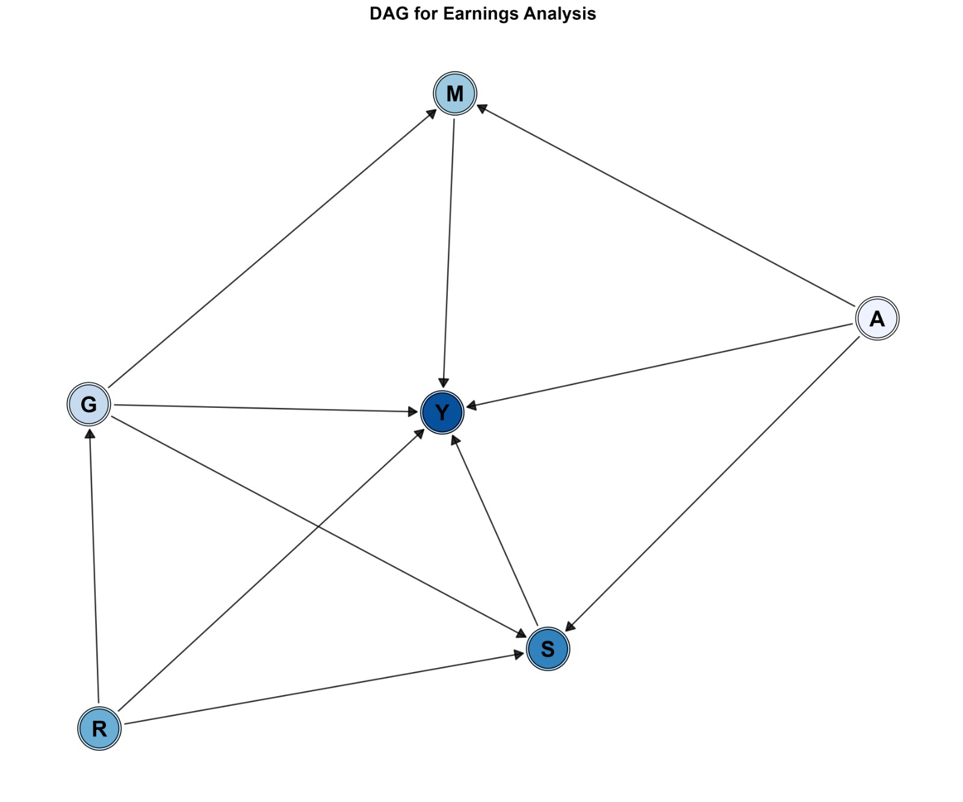
DAG
Y: Log hourly earnings
R: Region
G: Gender
A: Age
M: Marital Status
S: Schooling

Slide 11
02
Methods
Step taken

Slide 12
DATA CLEANING & FEATURE ENGINEERING
DATA CLEANING
COMBINED THE DATASETS {2021,2022}
RENAMED OUR VARIABLES
FEATURE ENGINEERING
ENCODING CATEGORICAL VARIABLES(MARITAL STATUS, REGION)
NON-LINEAR CONTINUOUS VARIABLES (AGE, AGE-SQUARED)
CREATING LOG-HOURLY WAGE OUTCOME VARIABLES
CREATING TREATMENT VARIABLES FOR COMPULSORY SCHOOLING

Slide 13
EXPLORATORY DATA ANALYSIS
FILTER NA’S AND INTERMEDIATE VARIABLES
CHECK IF MISSING VALUES ARE MORE COMMON IN CERTAIN GROUPS
CREATE PLOTS TO VISUALIZE THE ASPECTS OF THE DATA

Slide 14
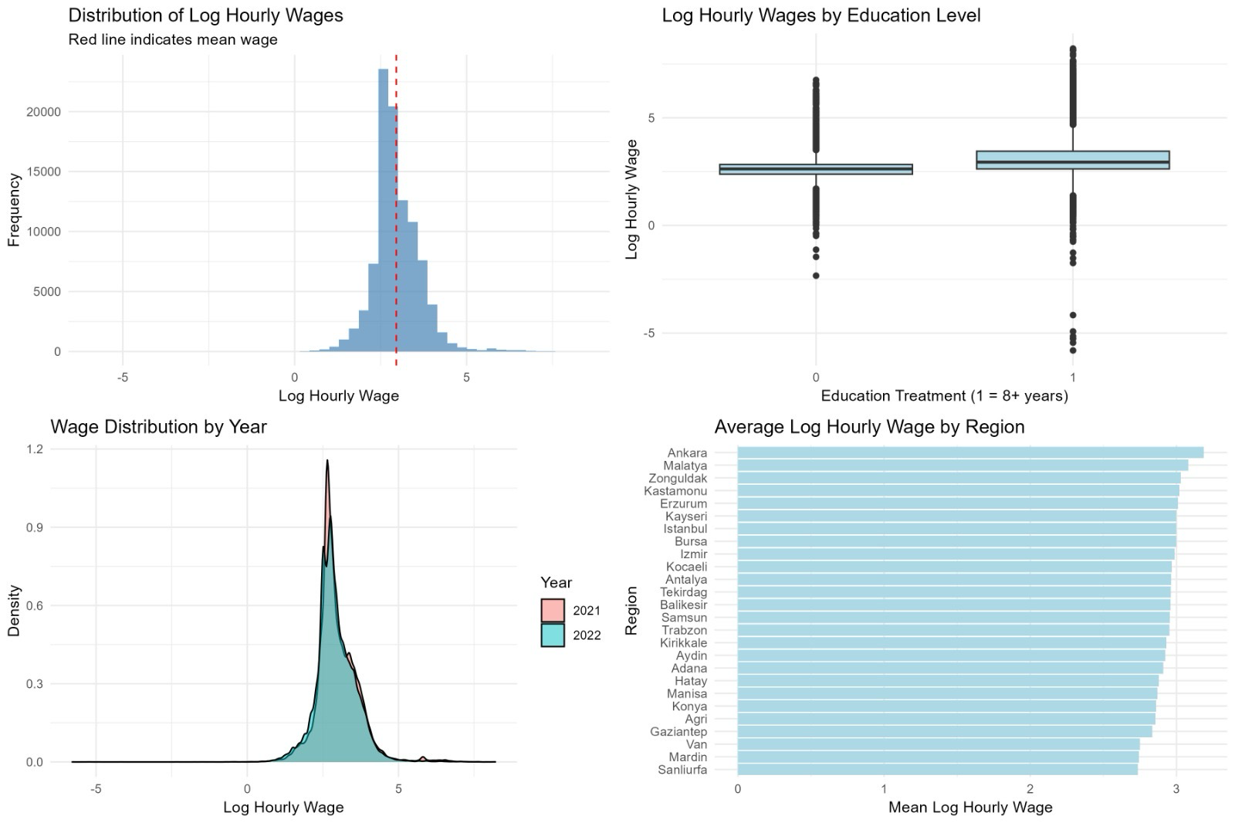
VISUALIZATION OF THE ASPECTS OF THE DATA

Slide 15
MACHINE LEARNING MODELS
CHECK THE BALANCE OF THE DISTRIBUTION OF THE DATA
REGRESSION MODEL
DOUBLE MACHINE LEARNING

Slide 16
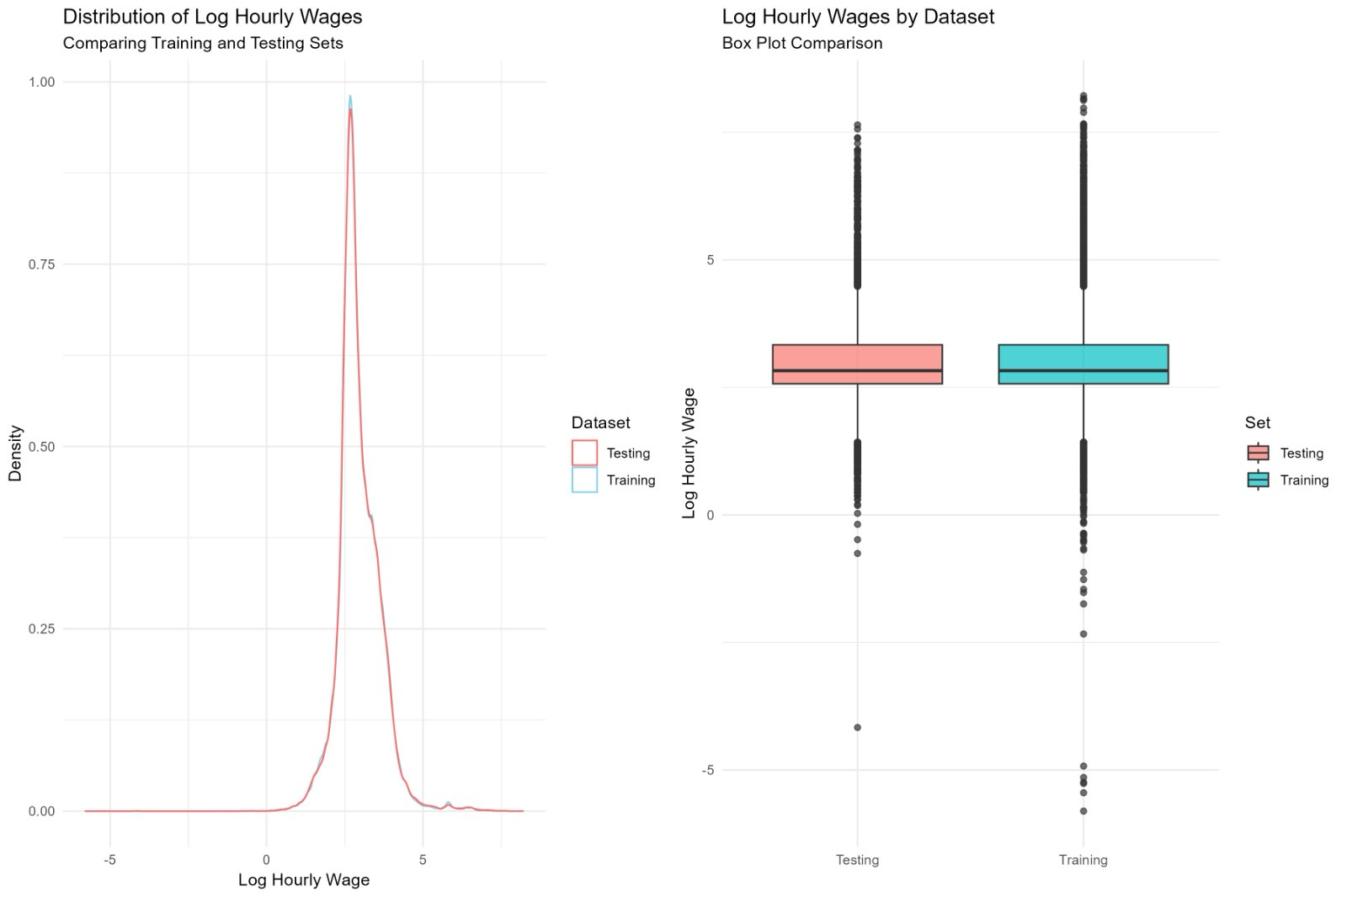
BALANCE OF DATA SPLITS

Slide 17
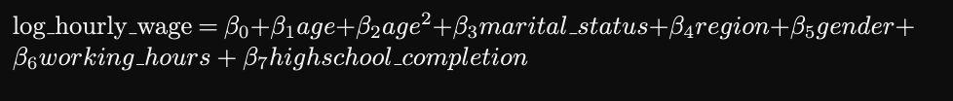
REGRESSION MODEL

Slide 18
DOUBLE MACHINE LEARNING
Prepare data for DML
Outcome variable (Y):log_hourly_wage,
Treatment variable (D):Highschool education,
Control variables (X): age, age_sq, gender, marital_status, region, working_hours
Create Double ML data object
Create learners for both stages
For predicting High-school education (classification task)
For predicting wages (regression task)
Create and fit DML model
Fit the model

Slide 19
03
Results
Outcomes and Limitations

Slide 20
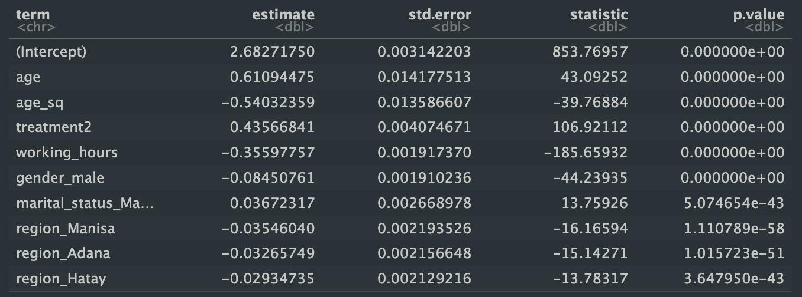
REGRESSION MODEL

Slide 21
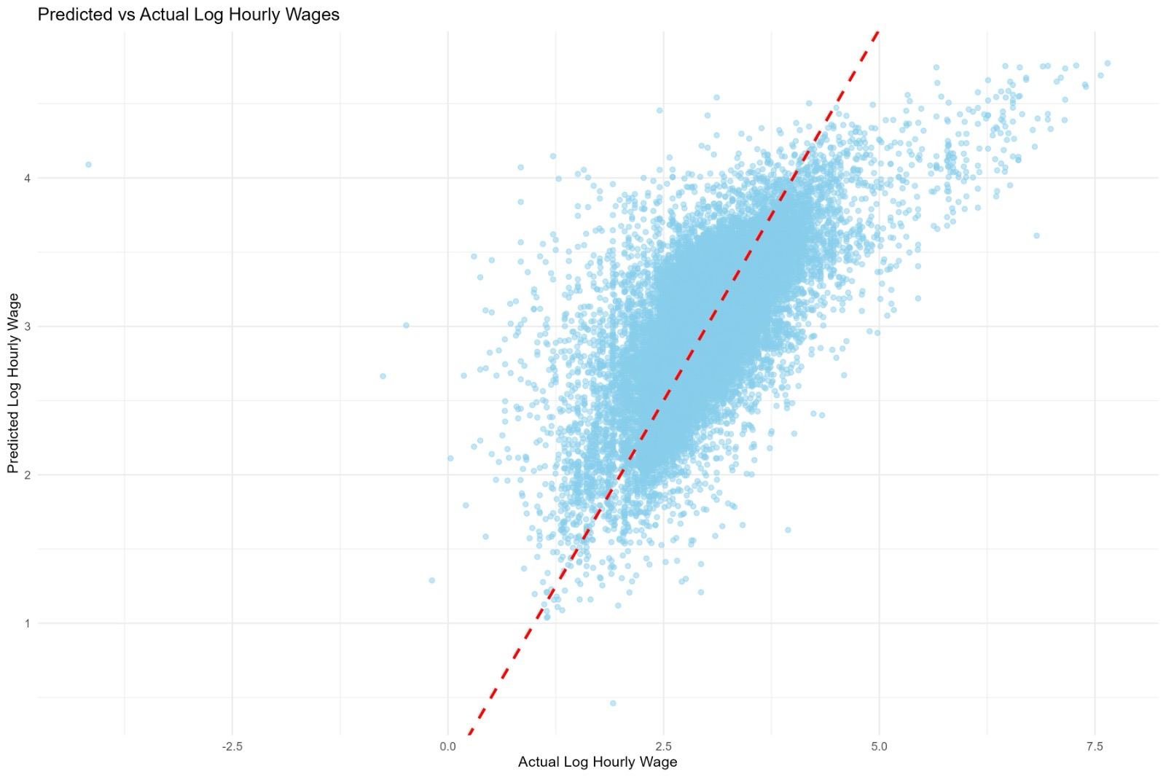
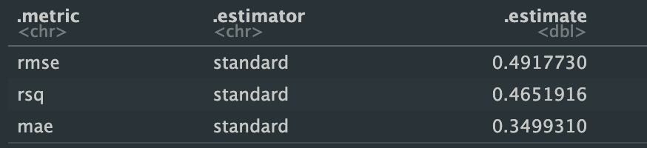
PREDICTED VS ACTUAL

Slide 22
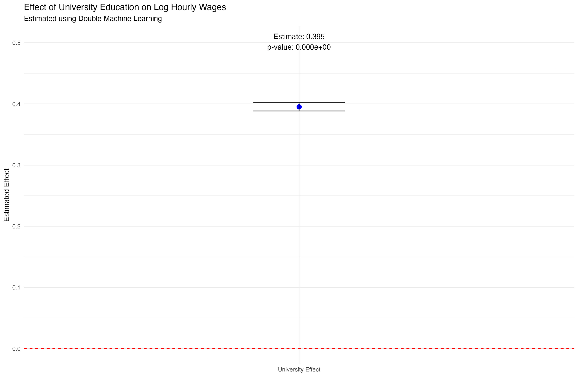
DOUBLE MACHINE LEARNING

Slide 23
Interpretation of Results
Comparing the estimates of Linear Regression and DML
LinReg estimated that completing highschool increases wages by 43% compared to people who did not.
DML estimated that same treatment has 39% effect on wages.
Statistical significance
From ~0 p-values we can argue that they are statistically significant
Causal Inference
DML removes the confounding effects on treatment variable hence its estimates can be used for causal arguments

Slide 24
Limitations
Our model validation relies on a single train-test split, which may not fully capture the model's performance variability. Implementing k-fold cross-validation would provide more robust performance estimates and better account for potential overfitting.
We face potential selection bias by only observing wages for employed individuals in our dataset. This could skew our estimates since we cannot observe the potential wages of those who chose not to work.
Our analysis assumes uniform returns to education across different demographics. However, educational benefits likely vary by gender, region, and age cohort. Including interaction terms or conducting subgroup analyses would provide a more nuanced understanding of the policy's impact across different population segments.

Slide 25
04
CONCLUSION
INTERPRETATION OF RESULTS

Slide 26
Research Question: Was “4+4+4” policy effective?
Baseline Model Linear Regression showed promising results with ~50% accuracy (RMSE) and it predicted completing highschool increased wages by 43%
Using the DAG we argued that there would be endogenous variation in our treatment variable (highschool completion, specifically gender and region)
Then we used a state-of-the-art Double Machine Learning Technique for eliminating this endogenous variation.
Our DML model predicted that highschool completion increases wages by 39% - 4% less than baseline prediction. We argue that this 4% was the overestimation of baseline model coming from endogenous variation.
Hence we argue that real effect of highschool completion is 39%, statistically significant and notably large.
Hence we conclude that policy change was a effective.

Slide 27
Thank you!

